Slide 1
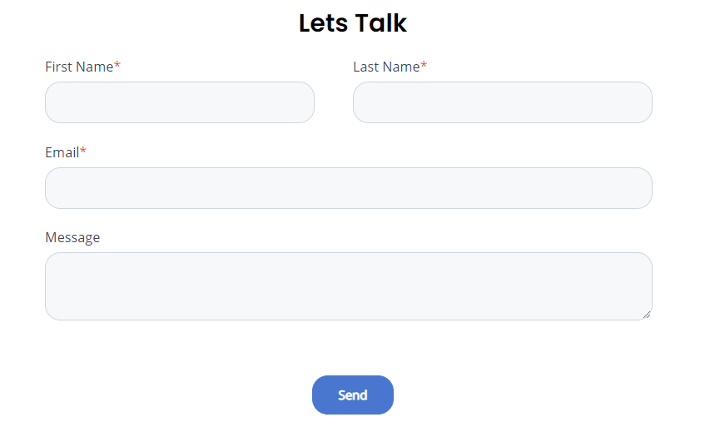


Contact Us:
info@strongpointconsulting.com
Global Headquarters
3935 Highknob Circle,
Naperville IL, 60564
630-807-9565
India Headquarters
601 H1 Riddhi Gardens,
Filimcity Road
Malad East, Mumbai 400097
Follow Us:

